Slide 1
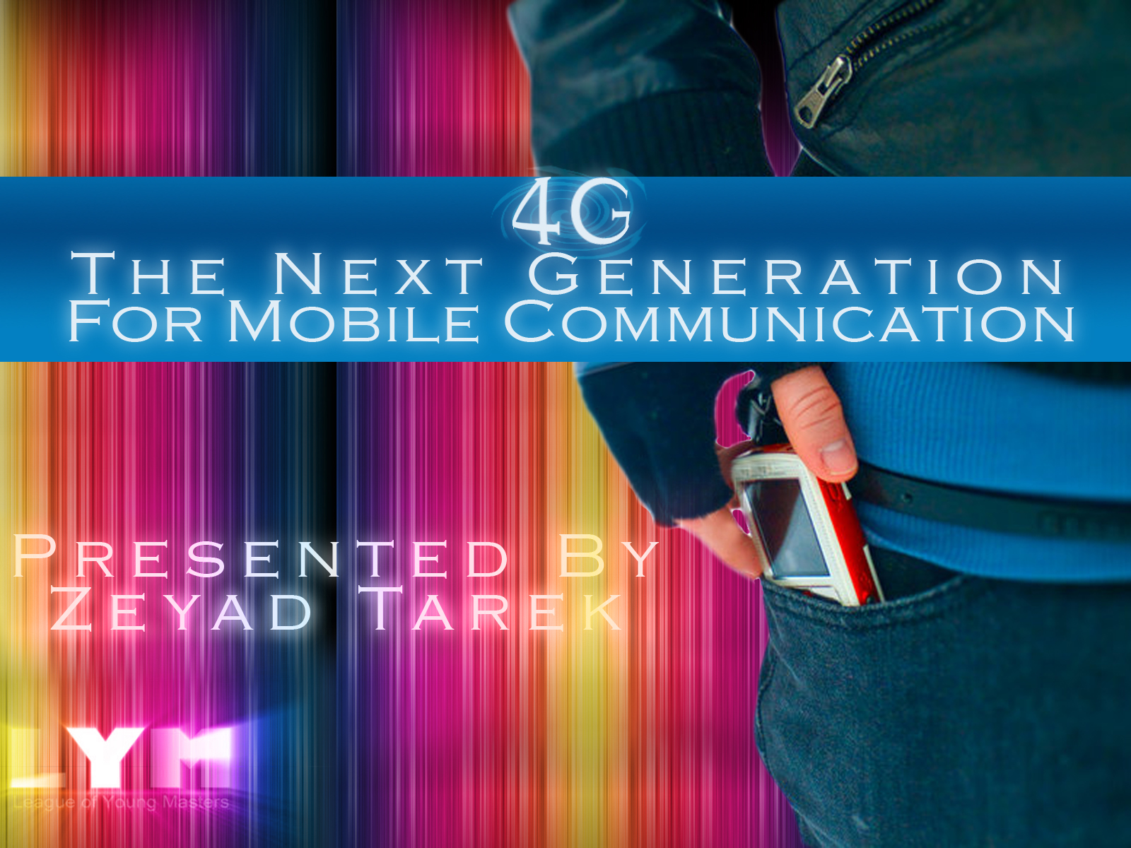
19 April 2009- 4G- Zeyad Tarek

Slide 2
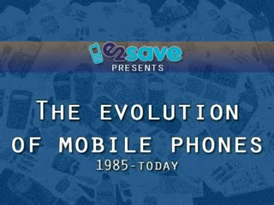

Slide 4
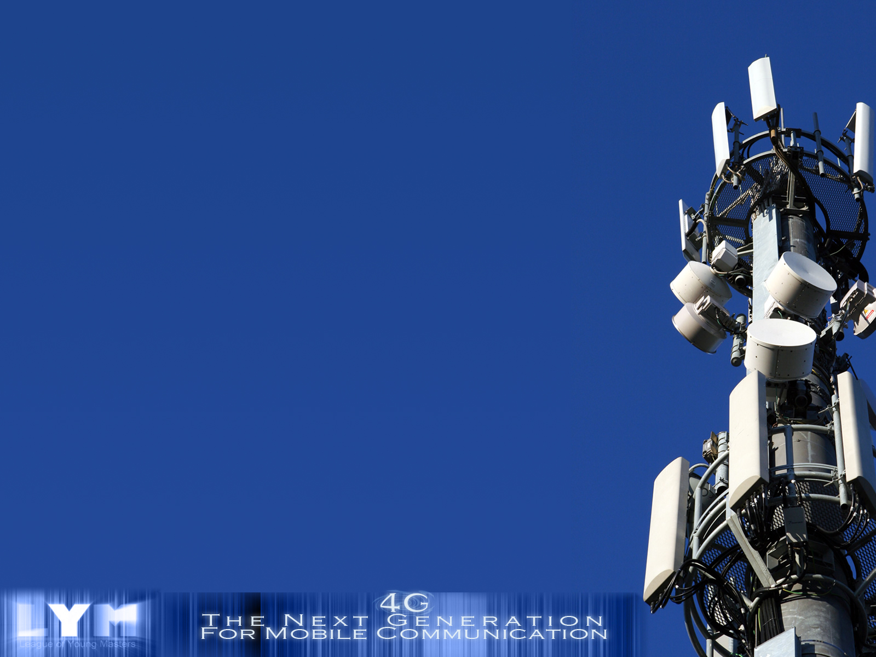
  Communication..?
  Mobile..?

Slide 5
Outlines
How the Phone Works
QoS And Some Other Concepts
From 1G to 3G
The 3G Technology and Beyond
Why We need to work on 4G
The Future of Mobile Communication Technology
References and Resources

Slide 6
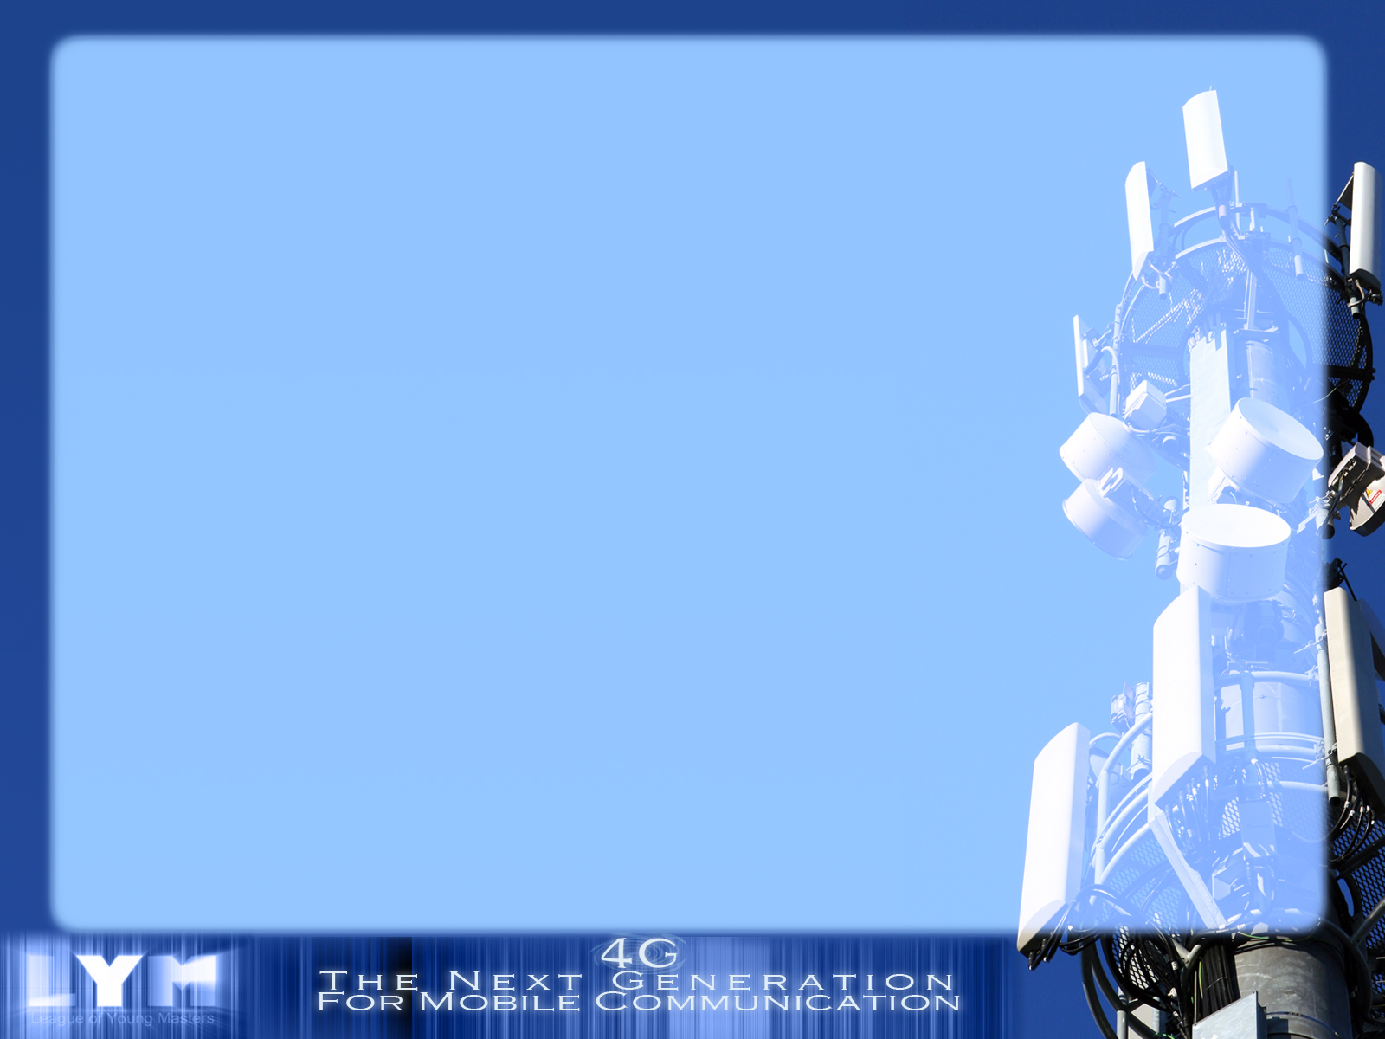
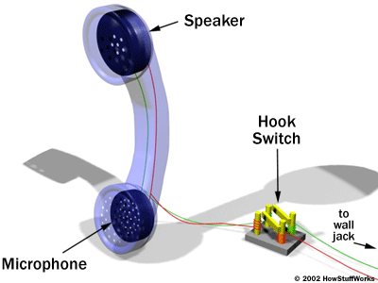
How the Phone Works

Slide 7
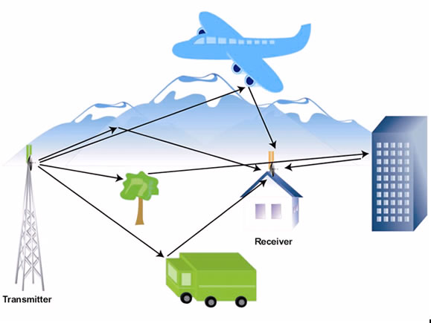
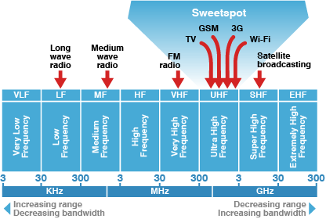
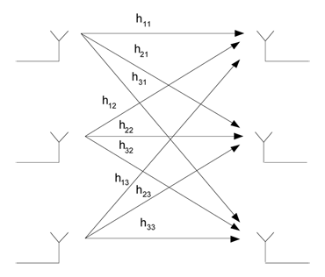
QoS and other Terminologies
Quality of Service (QoS)
Analog Vs. Digital
Data Rate
Wireless Channel: Downlink & Uplink
Multiple Access: TDMA, FDMA, CDMA
Frequency Band
Spectrum Efficiency
MIMO
Multipath Propagation
Noise and Interference

Slide 8
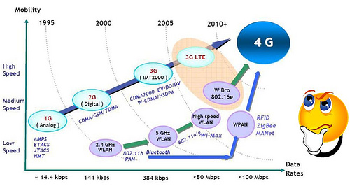
Mobile Evolution

Slide 9
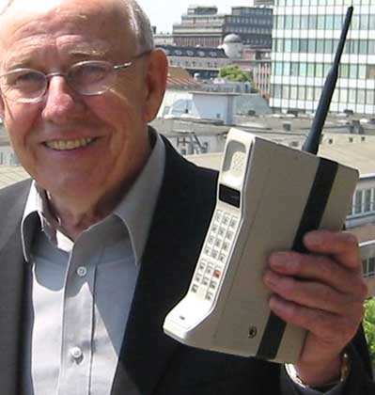
1G (Motorola DynaTac)
Installed Radio-Telephones in cars.
Central Antenna Tower Per City.
Only 25 Channels Available on Tower.
Needs A powerful transmitter.

Slide 10
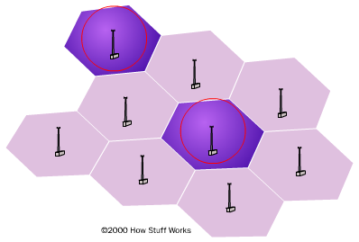
Frequency Reuse
Because cell phones and base stations use low-power transmitters, the same frequencies can be reused in non-adjacent cells. The two purple cells can reuse the same frequencies.

Slide 11
2G
Speed: 10Kb/Sec
Phone Calls
Voice Mail
Receive Simple Email Messages
Time to Download a 3min. Song:
31-41min
2.5G
Speed: 64-144Kb/Sec
Phone Calls/Fax
Voice Mail
Send/Receive Large Email Messages
Web Browsing
Navigation/Maps
Time to Download a 3min. Song:
6-9min

Slide 12
3G
Speed: 144Kb/Sec-2Mb/Sec
Phone Calls/Fax
Voice Mail
Send/Receive Large Email Messages
High Speed Web
Navigation/Maps
Video Conferencing
TV Streaming
Time to Download a 3min. Song:
11Sec-1.5min

Slide 13
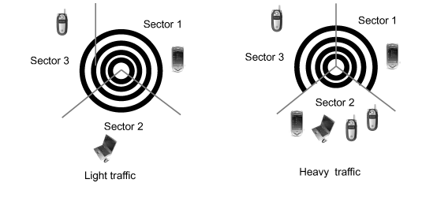
What is Wrong with 3G ?
→ Data Rates:
Some of the time data users are back on GPRS rates (50-300Kbps)
→ Latency :
In the range of 200-500ms, a very high latency by IP and internet standards, meaning that interactive games and real-time voice and video applications are impossible to use on most existing 3G networks.
Interference caused by any
transmission :

Slide 14
The Evolution of 4G
LTE (Long Term Evolution):
  is a 3GPP standard term for a completely new air interface based on OFDM and smart antennas and an all-IP network.

Slide 15
Requirements
Any Time-Any Where
  Wireless Broadband access
  MMS
  Video Chat
  Mobile TV
  HDTV Content
  Digital Video Broadcasting (DVB)
  Minimal service like voice and data.

Slide 16
Objectives
  A Spectrally Efficient System
  High Network Capacity
  A Nominal Data rate of 100Mb/s While Client moves at high speeds (320Km/hr), and 1Gb/s While Client and Station are relatively fixed.
  A data rate of at least 100Mb/s between any two points in the World!
  Smooth Handoff.
  Seamless Connectivity and Global Roaming across multiple networks.

Slide 17
New Innovation
  The future Smartphone will be based on open wireless architecture (OWA) technology which means, when you change the wireless standards, you do not need to change phone.
  Source:www.4gmobile.com

Slide 18
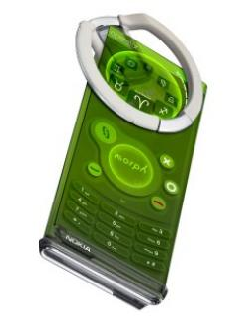
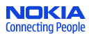
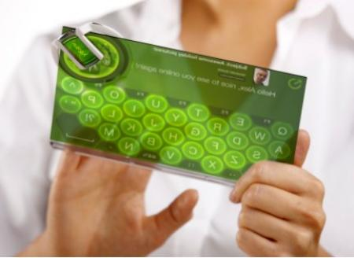
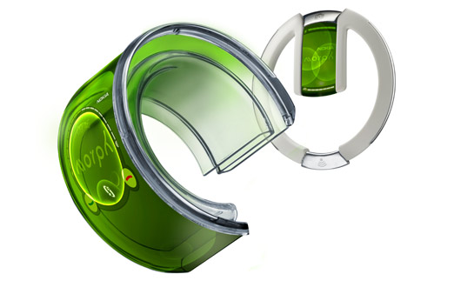
NOKIA Morph
Based on Nanotechnology
Completely flexible
Self-Cleaning
Advanced Power Sources

Slide 19
4G in Egypt 2012
By the end of 2008, Nokia Siemens Networks will be delivering the new LTE-ready hardware to more than 10 major mobile operators in Europe, Asia and North America.
According to a recent Dec. 2008 LTE Commitments list report, LTE will be available in Egypt by the Q2 of 2012 through the two leading Mobile networks Vodafone Egypt and Etisalat Misr.

Slide 21


Slide 22
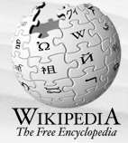
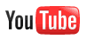

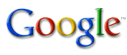
References and Resources
Dave Wisely, IP for 4G, John Wiley & Sons,2009
E. Dahlman et al., 3G Evolution: HSPA and LTE for Mobile Broadband, Academic Press, 2007
Jim Zyren, Overview of the 3GPP Long Term Evolution Physical Layer, White paper, 2007

Slide 23

Thank you!

